Slide 1

Dividend Distribution via Smart Contract
June 2022
Prof. Dr. Christian Ewerhart
Professor of Economics, University of Zurich
Member of the Steering Committee of the UZH Blockchain Center

Slide 2
Content
Background and motivation
Dividend distribution process
Security considerations
Final comments
Contact us
Dividend distribution via Smart Contract

Slide 3
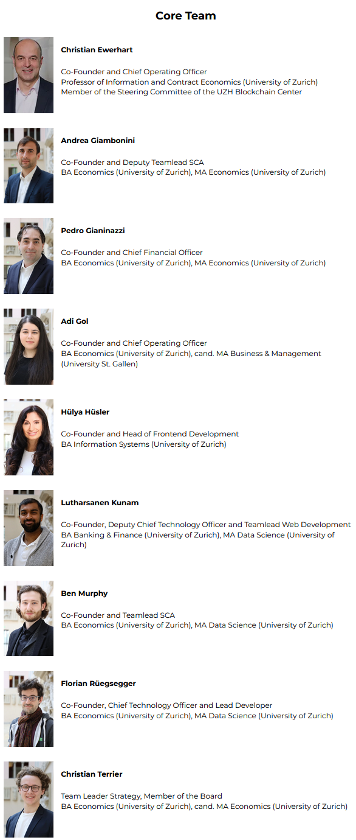


Background
Blockchain Presence AG is a Zurich based blockchain technology firm founded in December 2020 with the goal to develop and run a reliable, convenient, and cost-efficient smart contract oracle platform.
UZH has been ranked 4th globally in blockchain in 2021 (1st in Europe)
https://www.coindesk.com/learn/2021/10/04/the-top-universities-for-blockchain-by-coindesk-2021/
Blockchain Presence AG won the 3rd place at the 2021 Austrian Blockchain Award
https://www.linkedin.com/posts/blockchain-presence_bcp-wins-3rd-place-at-the-austrian-blockchain-activity
Dividend distribution via Smart Contract

Slide 4
Motivation
Equity Token
Paying dividends via smart contract is natural given tokenized shares.
Marketing Impact
Be among the first firms to distribute its dividends via smart contract!
Modular approach
Tokenization and dividend distribution may be easily separated.
Roadmap
Dividend distribution had higher priority than tokenization.
Dividend distribution via Smart Contract

Slide 5
Outline
Decision to distribute dividends via smart contract
Preparation
Further preparations
General assembly
Distribution process
“A motivated and hard-working team of UZH students, that were able to adapt to changing conditions quickly, was the prerequisite for the success of this project.”
Florian Rüegsegger (CTO)
Summer 2021
Late ‘21 – Early ‘22
April 6, 2022
April 2022
April-May 2022
“It was a challenging and nerve-racking project, but the outcome was satisfactory and the efforts have paid off.”
Qin Liang (Developer)
“It was truly rewarding to see the project succeed and the hard work and dedication we had put into it finally pay off.”
Qian Liang (Developer)
Dividend distribution via Smart Contract

Slide 6


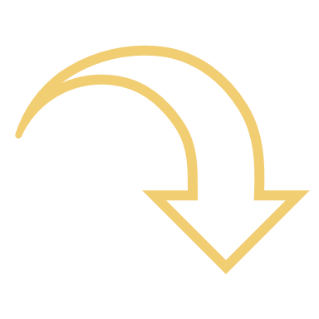
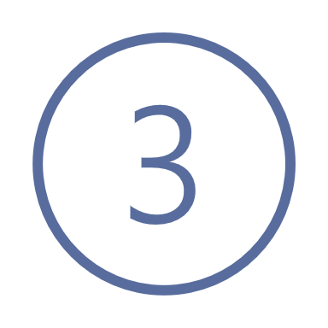

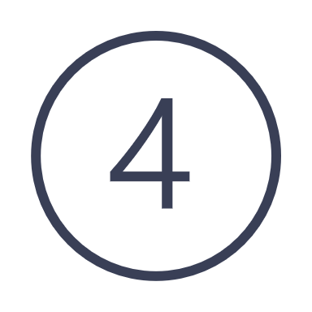

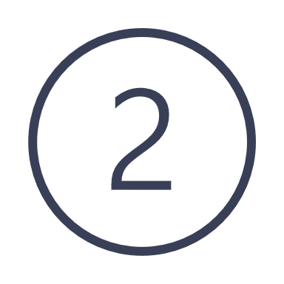



Dividend application
The application period lasted from April 9 to April 25, 2022
Let investors apply
Enable Application
Disable application
Reminder to apply
Application email
Start of preparations for the pull
Dividend distribution via Smart Contract

Slide 7


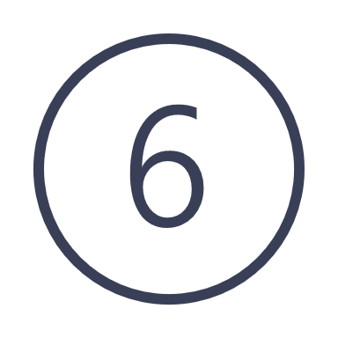



Dividend pull
The pull period lasted from April 29 to May 15, 2022
Enable pull period
Let investors pull
Disable pulling period
Reminder to pull
Issue dividend certificate
Pull email
Dividend distribution via Smart Contract

Slide 8
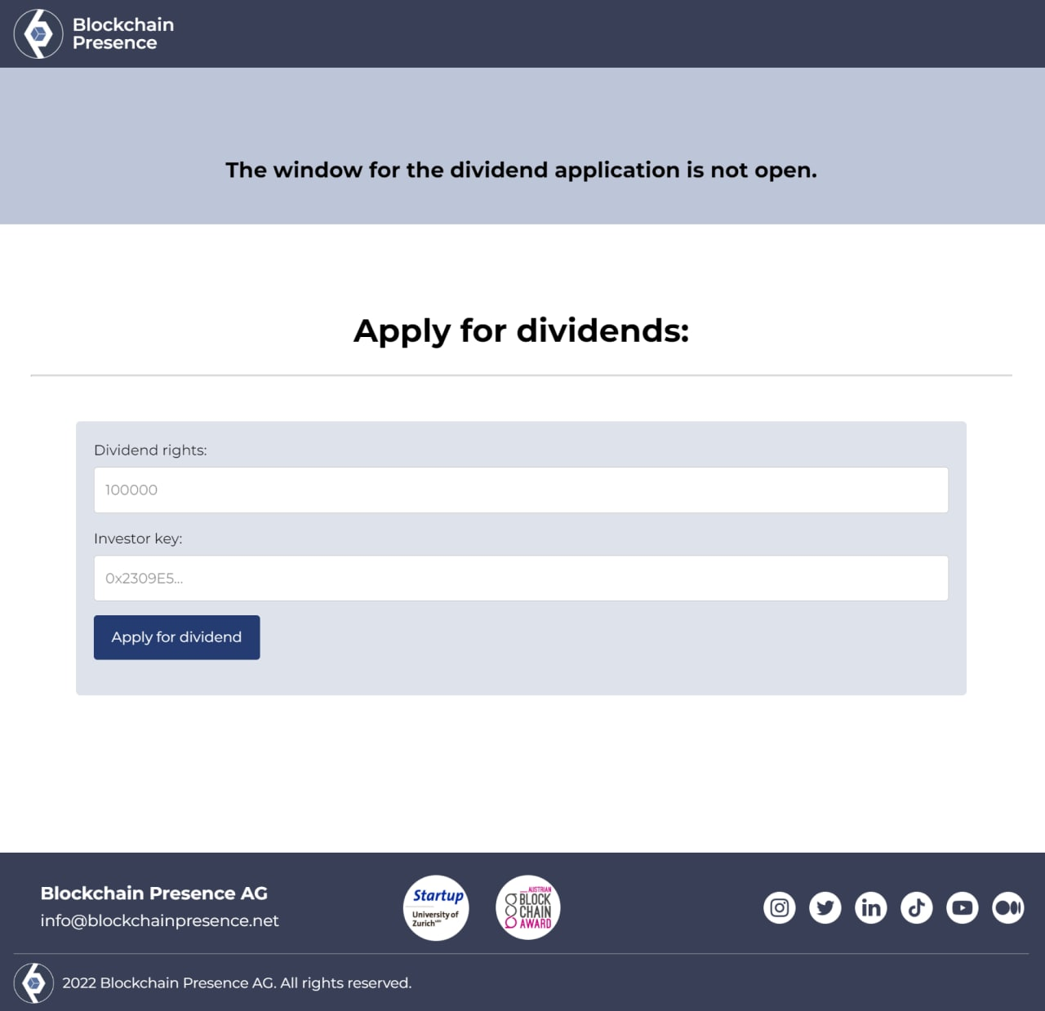
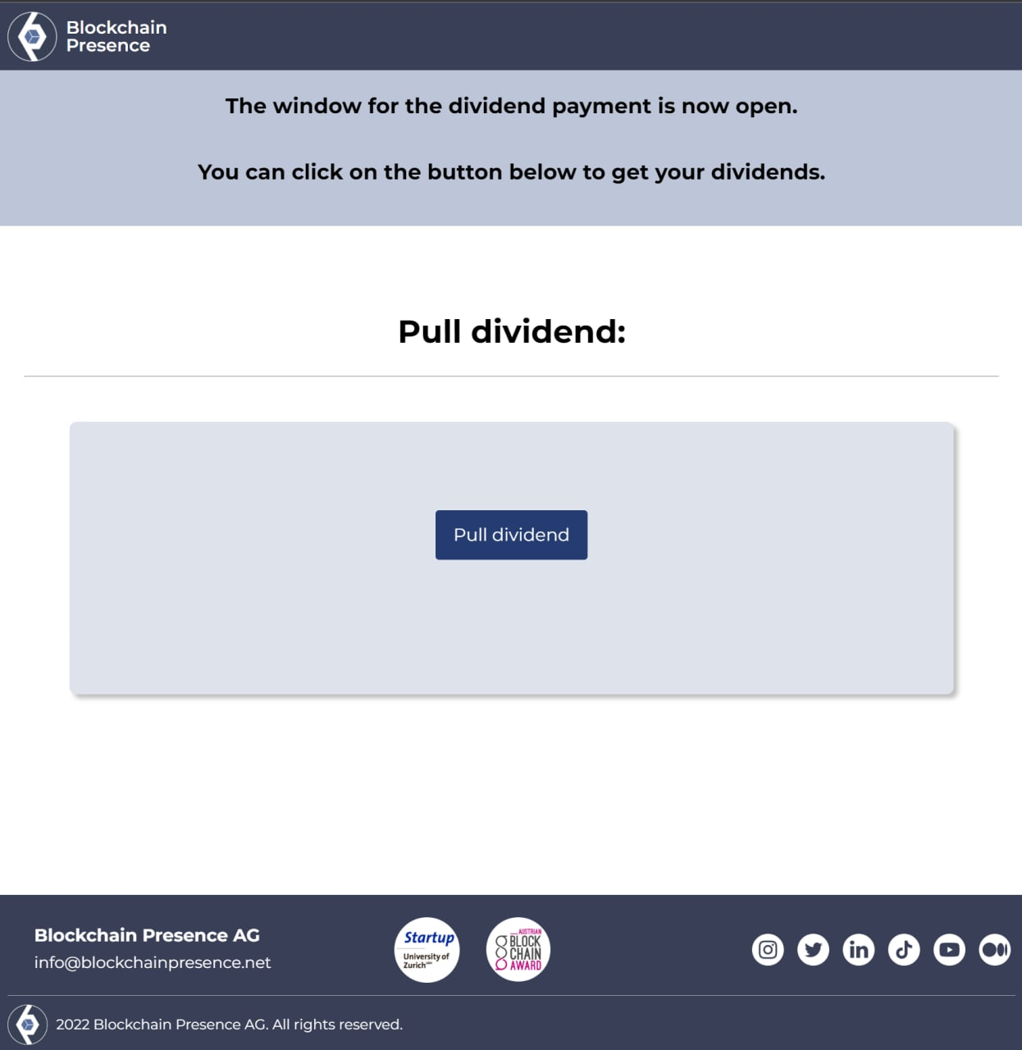
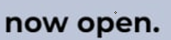
Shareholder webpage
Application
Pull
Dividend distribution via Smart Contract

Slide 9


Generate BCP & investor keys
The dividend distribution process was secured by two keys
BCP key
Investor key
Valid for one dividend year
Generated and stored offline (e.g., on a laptop disconnected from the internet)
Kept secret until the dividend pull period starts¹⁾
Thereafter, the key is published and used to validate dividend pulls
One key for each investor
Generated offline
Communicated to investors via email²⁾
Used by the investor to apply for the dividend
1) The BCP key is initially a private key, i.e., must be hidden until the dividend application has been disabled.
2) The investor key is always a public key, i.e., useless for third parties that have no access to the investor’s Polygon account.
Dividend distribution via Smart Contract

Slide 10
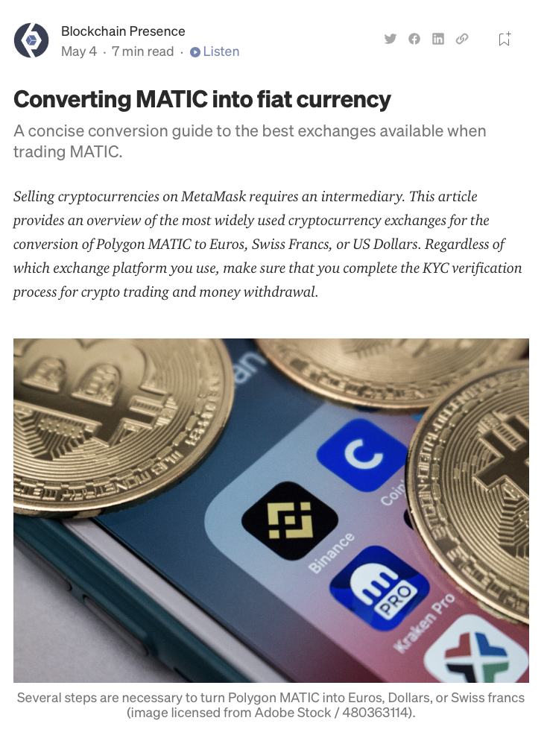
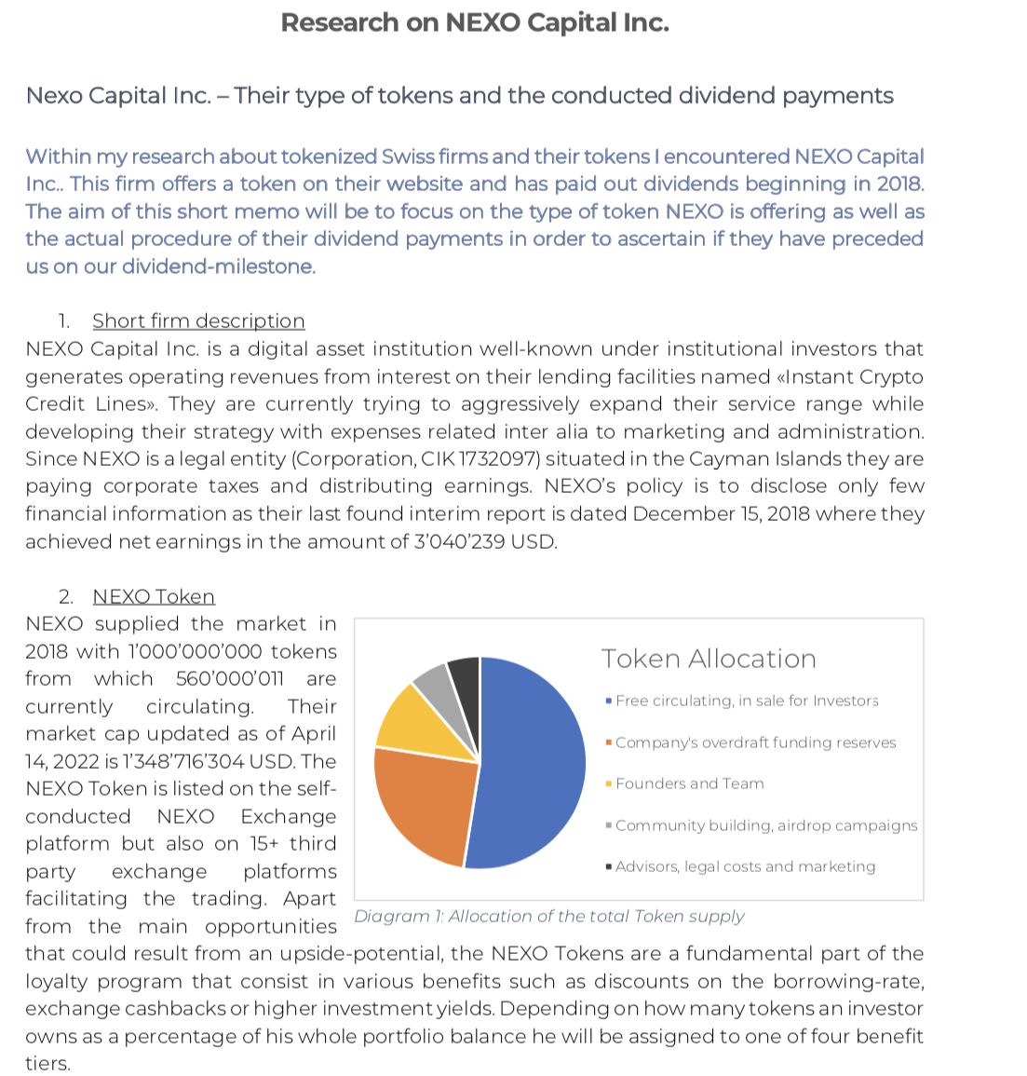
Final comments
Blog article on Medium
Alternative case: NEXO Capital
Next steps
Other companies
Different ways of converting MATIC into fiat currency
NEXO distributed their own tokens in 2018 but not later
Pros and cons of methods
No general assembly held
For our investors and everyone interested
No other known case of distribution
https://medium.com/the-blockchain-presence-blog/converting-matics-into-fiat-currency-8f433b7101ca
Dividend distribution via Smart Contract

Slide 11
BlockchainPresence.net
@BCPresence
@BCPresence
Blockchain-Presence
@blockchain_presence
Blockchain-Presence
@blockchainpresence

